Slide 1

Prehistory in the making

Slide 2


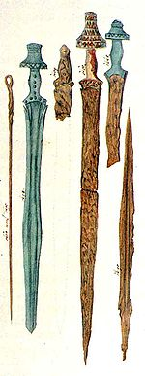
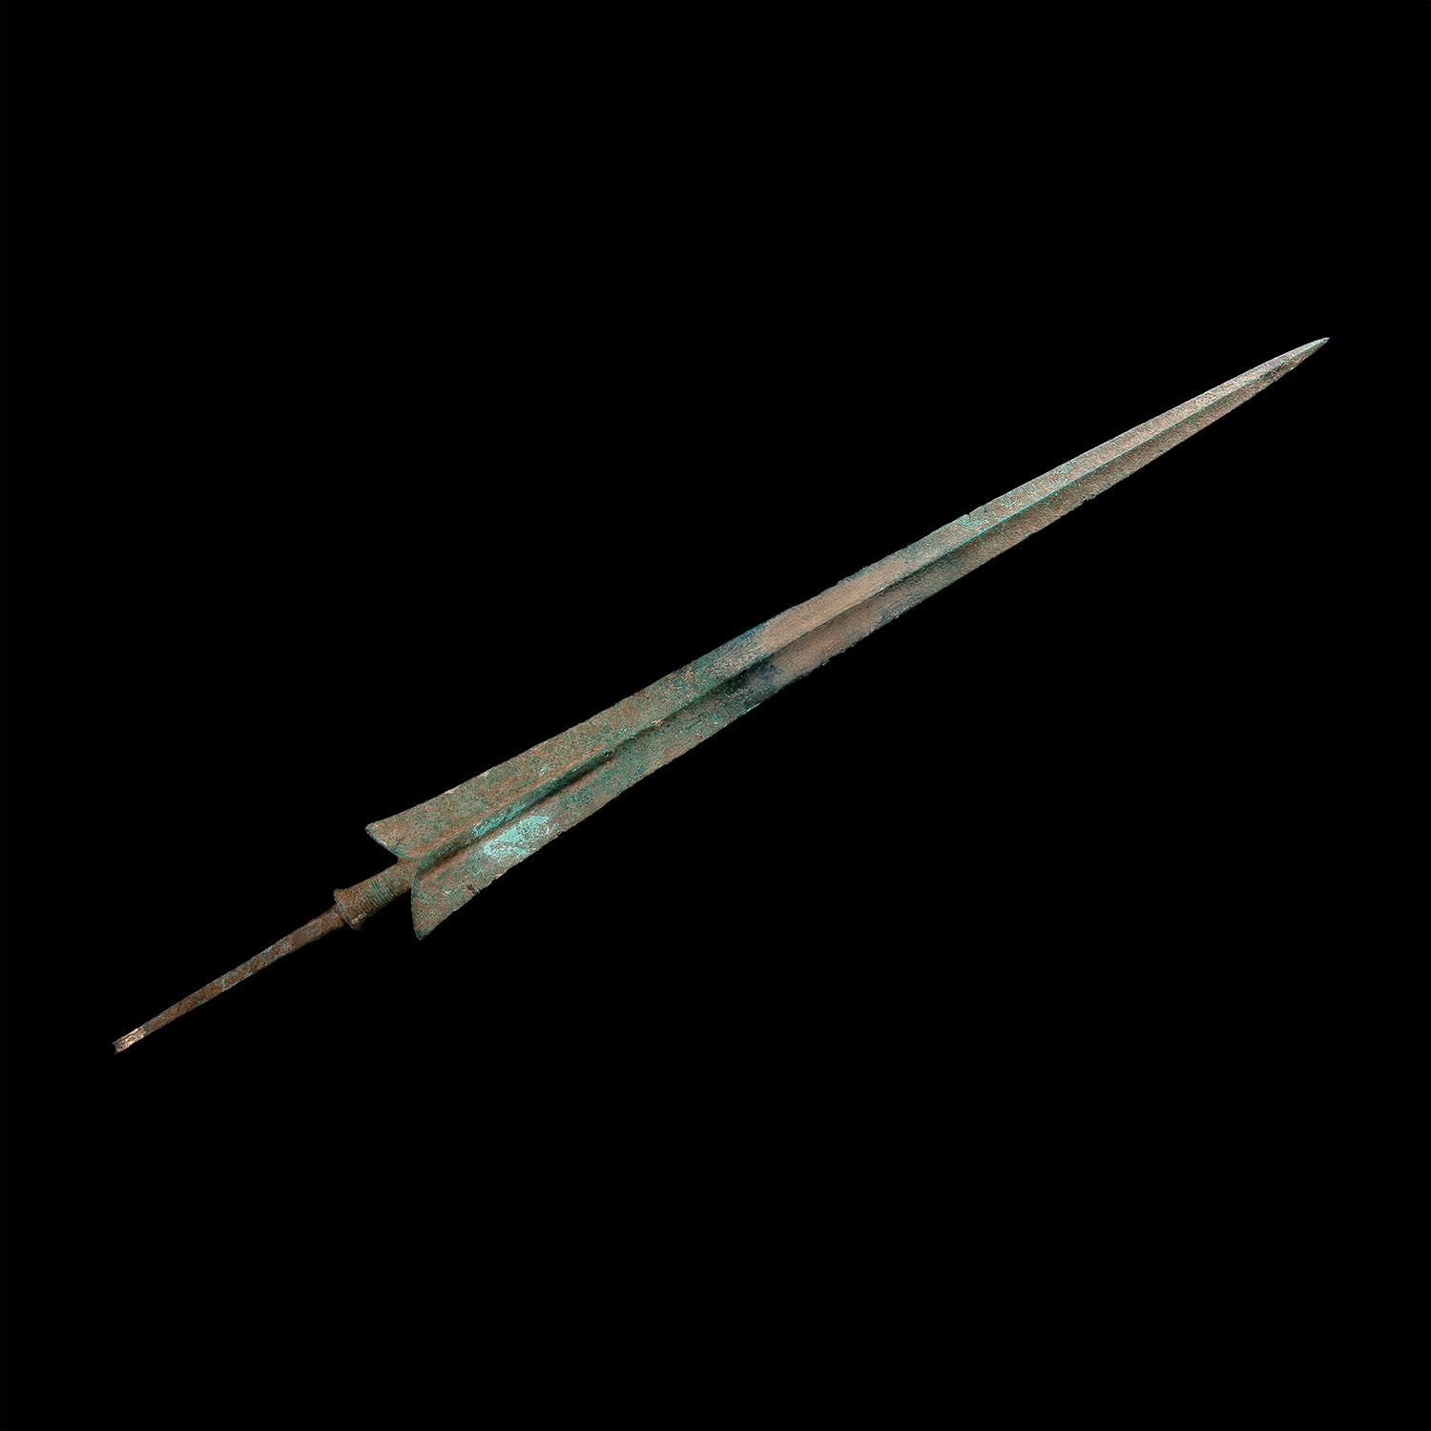
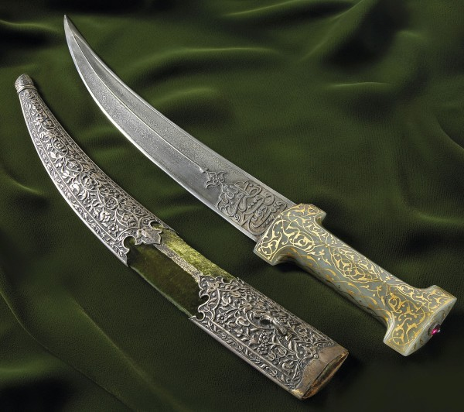
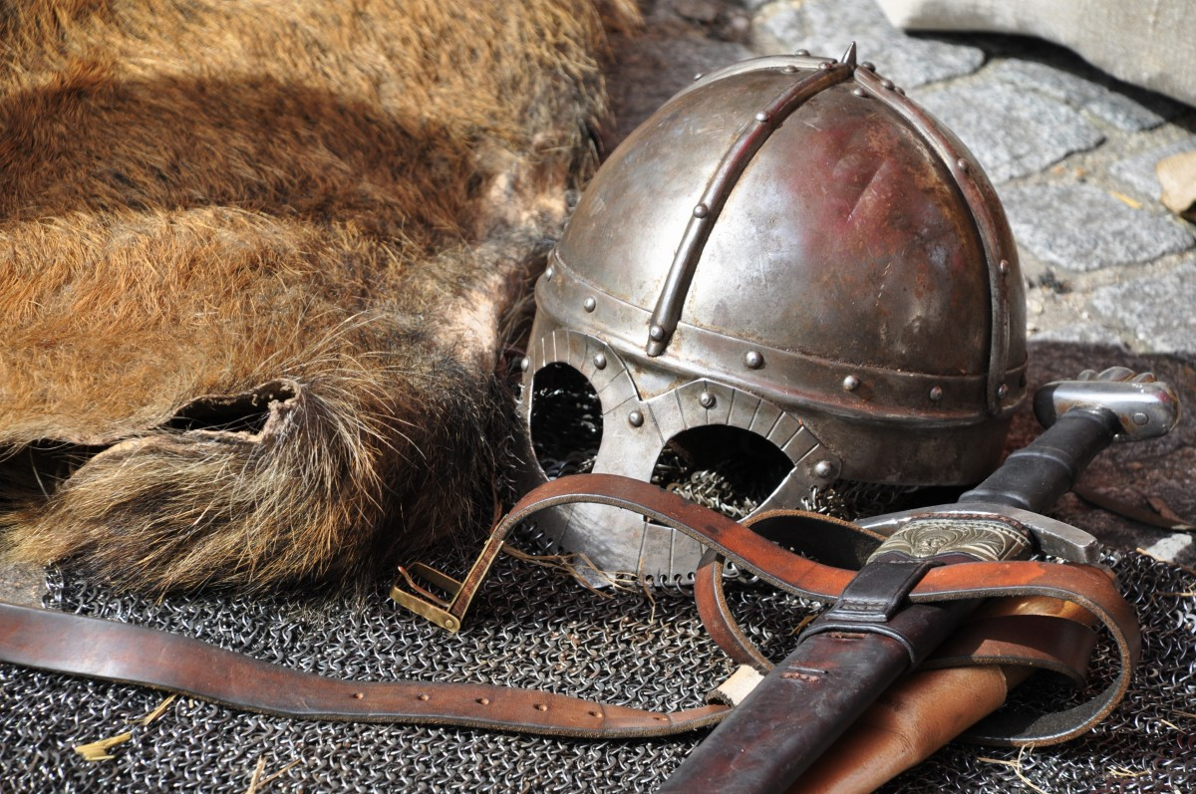
Iron Age
IRON AGE Facts
The iron age began around 1200 BCE.
Iron work began in a country which now is called turkey between 1500 and 1300 BCE.
The iron they made was used to make nails.
https://www.youtube.com/watch?v=j6rCMTOss_k

Slide 3
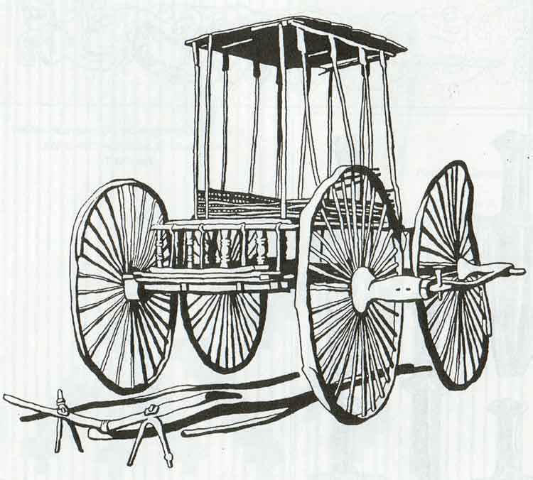
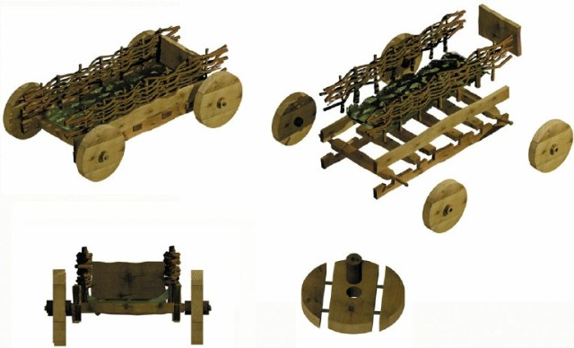
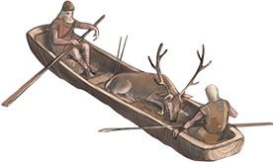
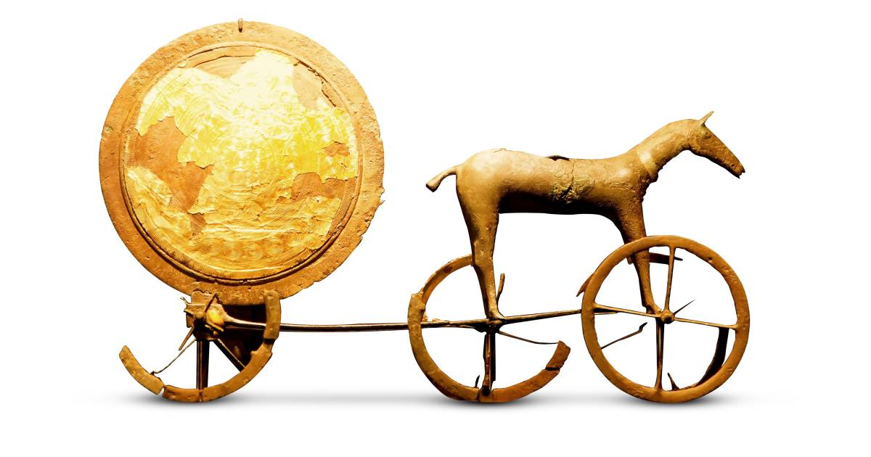
Bronze age
Bronze age facts
The bronze age lasted from about 2000 BC TO 800 BC.
The people of the bronze age made weapons out of a metal called bronze.
Archaeologists think that people became more organized in the bronze age.
https://www.youtube.com/watch?v=kd4dlNxaPwk

Slide 4
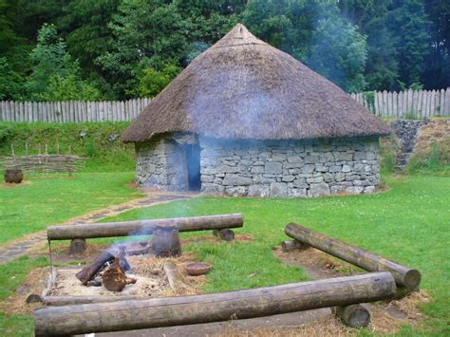
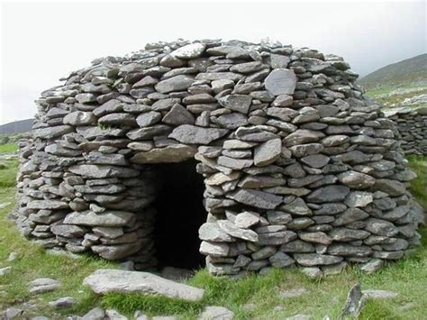
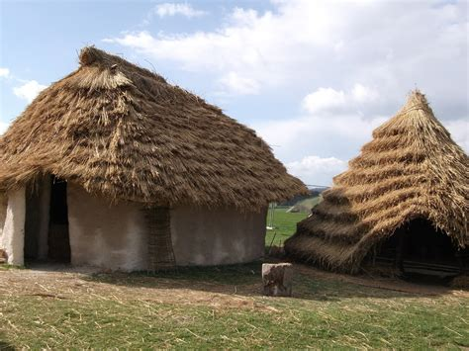
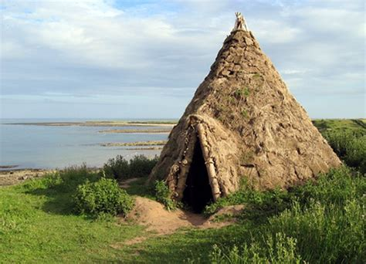
Stone age
Stone age facts
They made weapons out of stone and most houses out of wood and stone.
They existed about 3.4 million years ago.
They had no metal in the stone age.
https://www.youtube.com/watch?v=fDDlhCtIdQ4

Slide 5
The end
THANKS FOR WATCHING
☺

