Slide 1
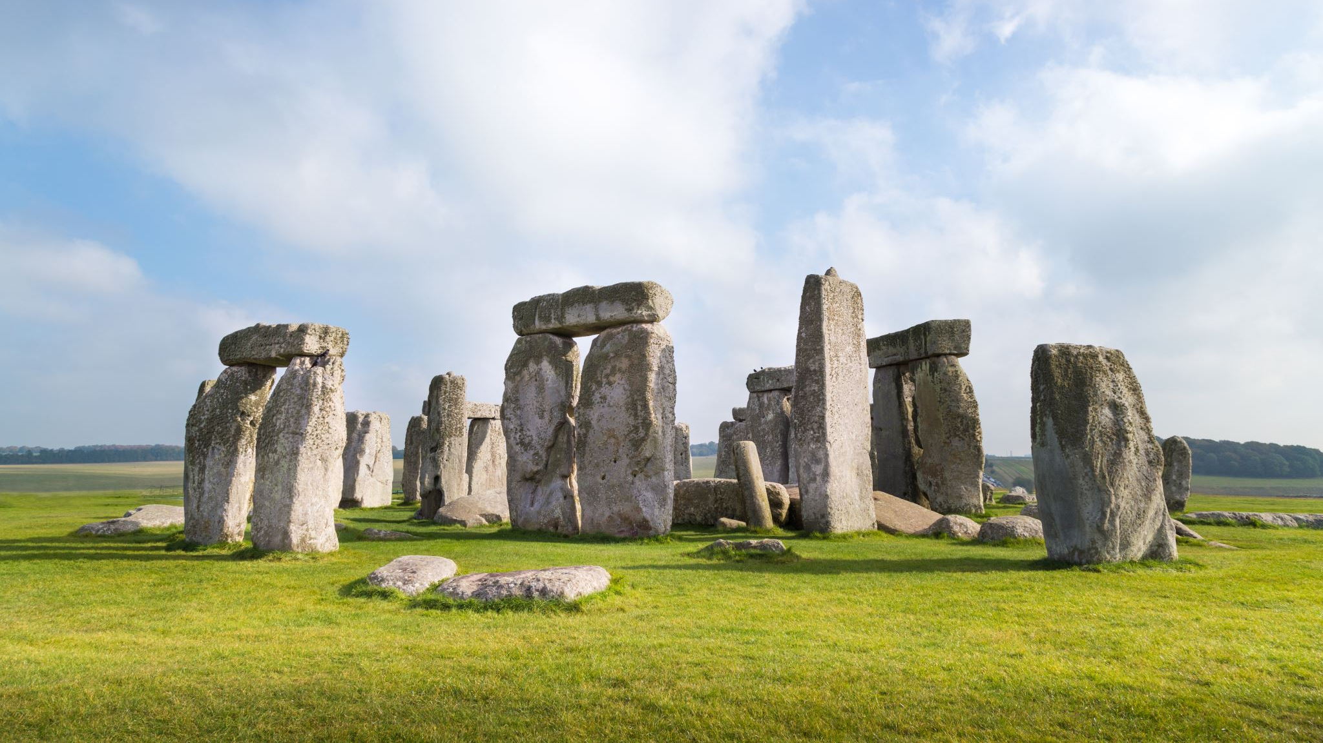
Pre-Historic Times
By Amy Honour

Slide 2
Topics
Click these links to go to the right slide you want
Stone Age
Bronze Age
Iron Age
Old Stone Age
Bronze Age Houses
Iron Age Food
Middle Stone Age
Top Five Facts for Bronze Age!
Top Five Facts for Iron Age!
New Stone Age
Top Five Facts for Stone Age!

Slide 3
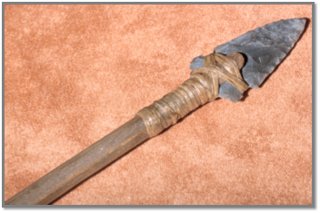
Stone Age
Click this to go to Topics
A Tool used in the Stone Age
The Stone Age was when the early humans used stone for tools. The stone Age began about 2.6 million years ago, when scientists found evidence of humans using Stone tools, and lasted until about 3,300 BC (When the Bronze Age began). The Stone Age is split up into three periods Old Stone Age (Paleolithic), Middle Stone Age (Mesolithic), New Stone Age (Neolithic).
Click this link to find out how the Stone Age build their tools!

Slide 4
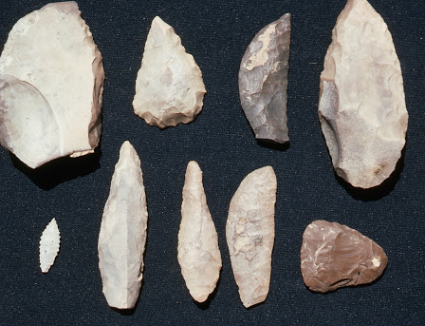
Old Stone Age
Click this to go to Topics
The Old Stone Age was the longest period in the history of the Stone Age. During the Old Stone Age, man gathered food by hunting wild animals and birds, fishing, fruits and nuts. The Neanderthals (Cave Men) existed during this period.
Click this link to find out more about the
Old Stone Age!
Old Stone Age Weapons

Slide 5
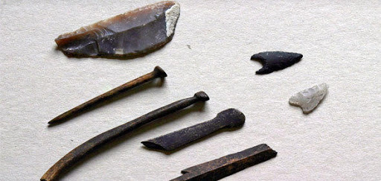
Middle Stone Age
Click this to go to Topics
The Middle Stone Age was a period of African prehistory between the Old Stone Age and the New Stone Age. The Middle Stone Age began around 280,000 years ago and ended around 50-25,000 years ago.
Click this link so you can find out more about the Middle Stone Age
Middle Stone Age Tools

Slide 6
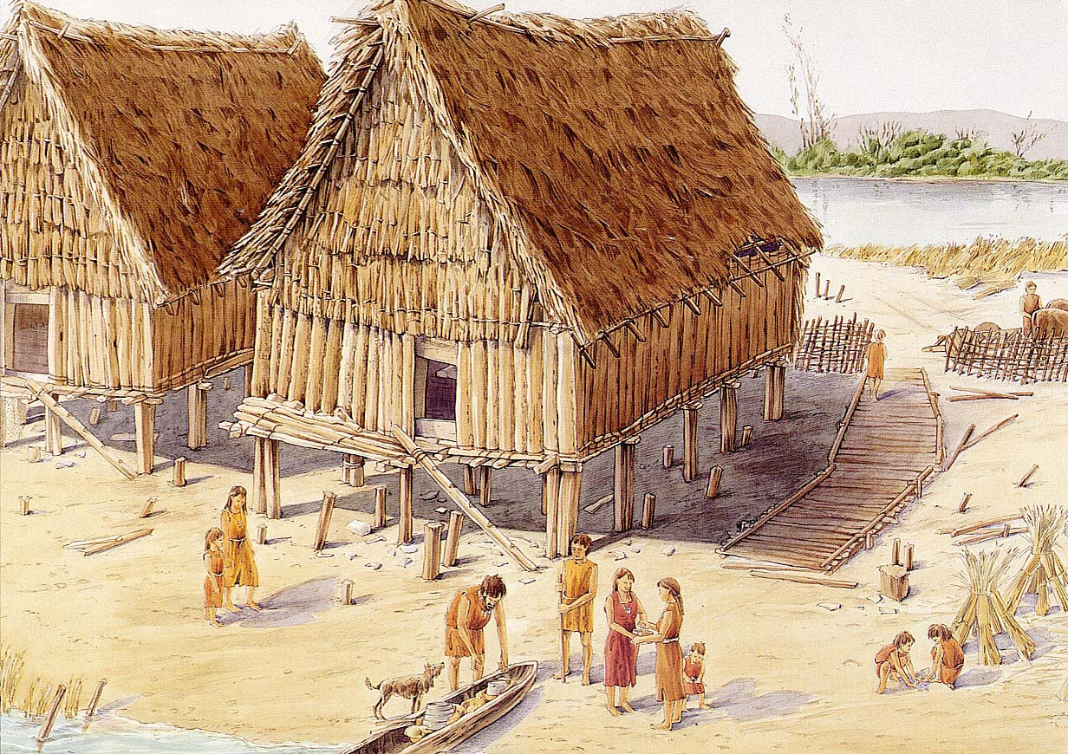
New Stone Age
Click this to go to Topics
The New Stone Age, the final division of the Stone Age, began about 12,000 years ago when farming began. It started about 10,000-4,500 BC
Click this link to find out more about the New Stone Age!
New Stone Age village

Slide 7
Top Five Facts For stone Age!
1. Did you know that Flint was commonly used for making stone tools but other stones such as chert and obsidian were also usfed?
2. Homo Alibis, an early human who evolved around 2.3 million years ago, was probably first to make stone tools.
3. Palaeolithic and Mesolithic people were nomadic hunter gathers. They Moved frequently following the animals that they hunted and gathering fruits and berries when they could.
4. The houses in Skara Brae, a Neolithic Orkney village, had beds, cupboards, dressers, shelves and chairs.
5. Some isolated tribespeople were still effectively living in the Stone Age as recently as the twentieth century.
Click this to go to Topics

Slide 8
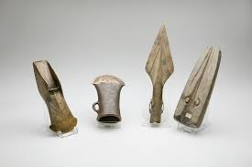
Bronze Age
Click this to go to Topics
These are Bronze Age tools and weapons
In Britain, the Bronze Age started around 2,100 BC and ended at 650 BC. Bronze is a mixture of tin and copper. Bronze could be used to make a greater range of tools and weapons than previously been possible.
Click this link to find out how the Bronze Age made tools!

Slide 9
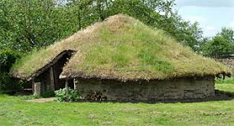
Bronze Age Houses
Click this to go to Topics
How did they build here houses in the Bronze Age?
The Bronze Age houses was made out of wood, stone filled with wattle, woven wood and daub which is a mixture of mud and straw.
What did they have in their houses?
The Bronze Age houses are quite simple inside because all they have inside are a bed a dresser and some other things you might have in your bedroom.
This is a Bronze Age house!

Slide 10
Top Five Facts For Bronze Age!
1. Did you know that the Bronze Age is the name given to the period of time between the Stone Ages and the Iron Age.
2. Growth of the trade for bronze and bronze products was aided by improved navigation skills. Knowledge of a astronomy and maths also developed during this period.
3. The invention of the wheel meant that animal-drawn vehicles could drive along tracks and roads.
4. Some Bronze Age societies developed a ruling class who were supported by military power.
5. The potter’s wheel and textile production meant that better pottery and clothing could be produced.
Click this to go to Topics

Slide 11
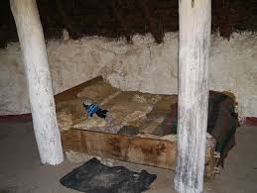
Iron Age
Click this to go to Topics
This is a replica of a Iron Age Bed
The Iron Age was a period in human history that started between 1200 BC and ended 600 BC, depending on the region, During the Iron Age, people across Europe, Asia and parts of Africa began making tools and weapons from iron and steel
Click this link to find out more about the daily life of a person from thousonds of years ago!

Slide 12
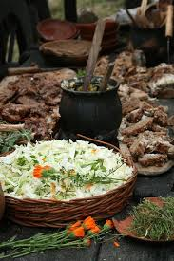
Iron Age Food
Click this to go to Topics
What Did They Eat?
Iron Age people ate crops like wheat, barley, peas, flax, beans. They also at meat like cattle, sheep and pigs
How Did The Iron Age Cook?
Most of the cooked food would have been cooked on a open fire which would have been done either outside during the summer or inside on a large central open-hearth during the winter. The hearth would cook food, provie warmth and give light and the fure would hae been maintained 24 hours a day.
This is what a Iron Age feast would look like

Slide 13
Top Five Facts For Iron Age
1. Did you know that Iron was tougher than bronze and could be shaped into finer and sharper objects. It required heating and hammering to make into tools and implements?
2. The diets people ate, the houses they lived in and the customs they followed varied depending on which part od the country they inhabited.
3. The Roman name for the inhabitants of the British Isles was Britons. The Britons were part of the Celtic people who lived throughout Northern Europe at this time.
4. As farming became more productive he population began to rise.
5. Grain was stored in granaries or in underground vaults. Meat or fish could be preserved by salting or smoking.
Click this to go to Topics

