Slide 1
Prehistory
Stone age, Bronze age and Iron age
By Harry McDowall

Slide 2
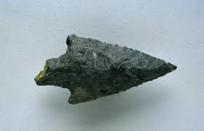
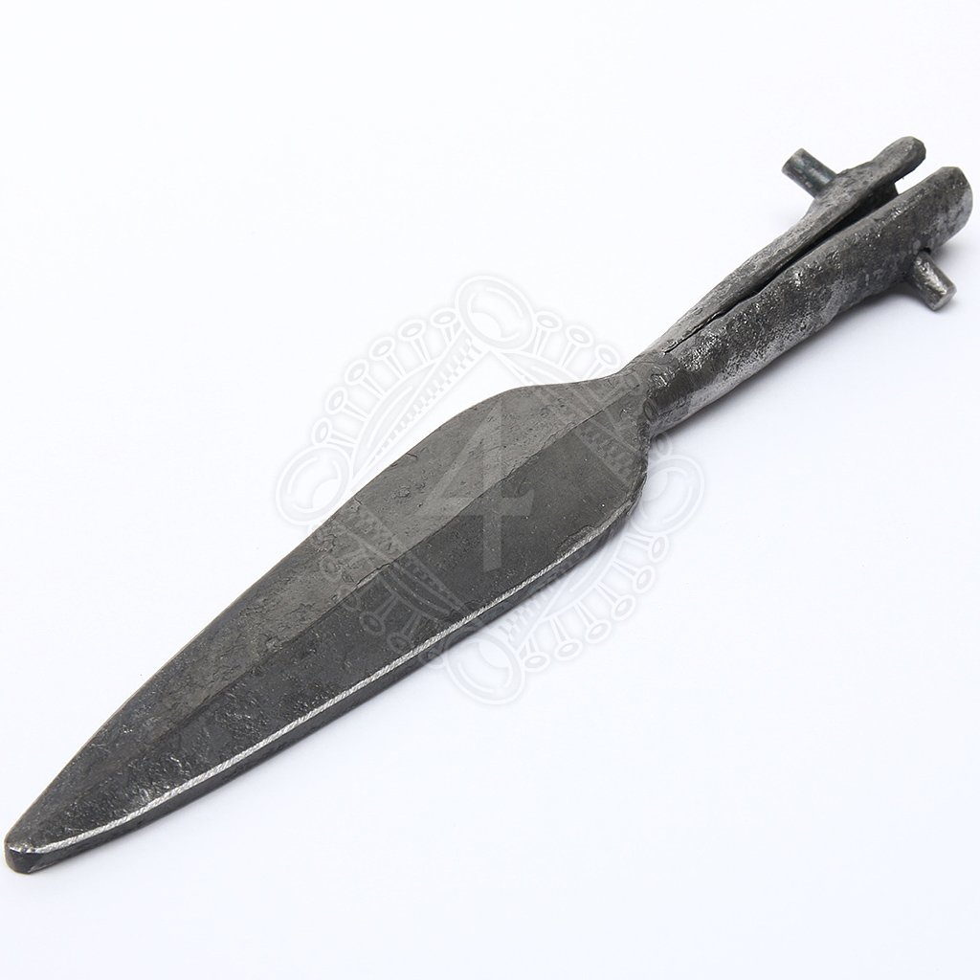
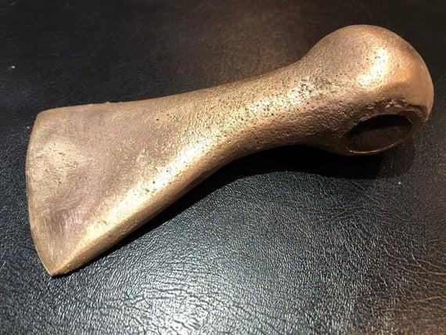

Prehistory
Have you ever wondered what life was like before you parents, grandparents and even you great-grandparents? Well, this period was known as prehistory. Prehistory was split into 3 periods: The stone age, bronze age and the Iron age. As the names suggests, each of the ages progressed from stone to bronze to Iron throughout history.
Stone arrowhead Bronze axehead Iron age spearhead

Slide 3

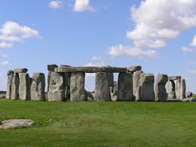
The stone age
Starting at 15,000 BC and finishing at 3350 BC, The stone age was a big time for humans. The neanderthals were no longer in britain as it was now only homo sapiens. Homo sapiens had started to work out how to make tools out of stone. People at the start of the stone age would have mostly survived on wild nuts, berries and meat. At the end however, they started to farm and grow crops! If you want to find out about farming and homes try watching this video:
As you may have guessed, the stone age was when
stonehenge was built. It was used to tell the time!

Slide 4
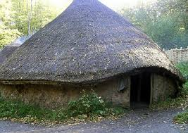

The bronze age
From 2100-750 BC another big change in the way we live occurs. People started making tools and weapons out of bronze { a mixture of copper and tin } instead of stone. Bronze is easier to work with and therefore better than stone. It is very strong but easy to make. They had weapons such as shortswords, daggers, bow and arrows and axes. Another big change in the way they lived in the bronze age was the weather. It had become warmer and dryer at the end of the stone age but now it had become wetter again. People were forced into the valleys were it was easier to find food and shelter. People had also started wearing tunics and skirts made from cotton.
Roundhouse

Slide 5

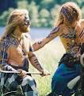
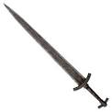

Iron age
From 8OOBC until the roman conquest in 43 AD, people started using Iron and steel instead of bronze. The people living in europe in the Iron age are referred to as celts. They were referred to as the ‘Britons’ by the romans. During the Iron age, britain consisted almost entirely on settled farming. This meant that nearly everyone lived on a farm. Similar to the bronze age, most of the farm houses during the Iron age would have been roundhouses. There was a fire in the middle of every house to keep the inhabitants warm! One big step up from the iron age in terms of protection was the celtic warriors. They were described by the romans who met them as strong, fearsome characters with white spiked up hair and blue painted bodies.
Celtic warrior

Slide 6

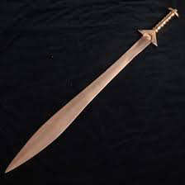

Conclusion of Prehistory
Prehistory { Stone age bronze age and Iron age }was a very important part of how we live today. People started working with metal and stone as well as learning how to farm and grow crops! Without them we might still only be eating wild nuts and berries today! Some scientists believe that how they lived back then is how we should be living today. This tells us that the people in the iron, bronze and stone ages were probably very clever. Just because they were alive along time ago it doesn’t mean they were stupid!

