Slide 1
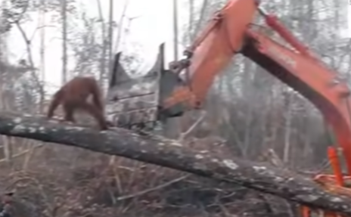
Name: Laurie Hot Write
The Times
Onslaught on Orangutan
At around 12:00, in the Borneo rainforest, a tree was chopped down and an orangutan came down with it. After a brief attack, the orangutan was knocked off the tree and tranquillised, midway through attacking the righthand side when the effects of sedation took effect.
After a few weeks of the rainforest being worked on by the diggers, it was already only two thirds of the original size and it is estimated that 8,500 plants and animals have been destroyed already. While the digger driver was being interviewed, he claimed, “I was jus’ followin’ m’ boss’s orders go’ a ge’ y’ cash some ‘ere y’ know.” He also claimed that he felt threatened by the orangutan when it attacked him and felt that he was more important that the orangutan.
Halfway along the planned logging ground, an orangutan was spotted but was not approached carefully and even the signs of aggression such as pacing and creating a wider posture were ignored causing the orangutan to lash back. “We here at Loggers Incorporated can care for all animals, proper protocols are organised and will be enforced,” claimed the C.E.O of Loggers Incorporated stiffly.
The spokesman of Loggers Incorporated
later claimed that the actions of their employees are not controlled by the company and must be considered as separate entities.
Animal control was contacted by a local farmer and was deployed to the scene immediately, properly equipped to defuse the situation. After arriving at the scene they were horrified to watch the orangutan being hit off the tree by the insolent digger driver and animal rescue was forced to tranquilise the orangutan. In an interview, the responder who tranquilised the orangutan stated that it was a regrettable incident.

Slide 2
Headline – short, punchy, alliteration, play on words (pun)
Quotes – reported or direct speech
Introductory statement – who,what,when,where,why,how
Facts (it is certain) and opinions (many believe)
Formal tone
Third Person
Chronological order
Mainly past tense
Conclusion

