Slide 1
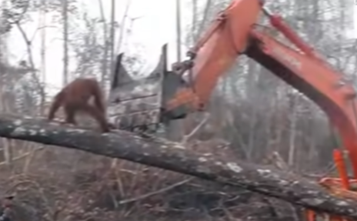
Name Jack Hot Write
The Times
ORANGUTAN FIGHTS OFF DIGGER.
As some of you may have seen, there is a disturbing video of a orangutan defending its habitat when a big digger started digging up trees.
The orangutan tried to stop the man in the digger but the orangutan was pushed off by the digger. The man was cutting the tree for palm oil which is used for tooth paste, soap and food. With so many people using it, this could cause
The orangutan species becoming extinct. Let’s try to use less palm oil to help the animals. Some experts talk about this and said this should never happen again.
Reported by Jack

Slide 2
Headline – short, punchy, alliteration, play on words (pun)
Quotes – reported or direct speech
Introductory statement – who,what,when,where,why,how
Facts (it is certain) and opinions (many believe)
Formal tone
Third Person
Chronological order
Mainly past tense
Conclusion

