Slide 1
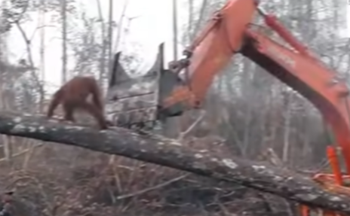
Name: Izzy Hot Write
The Times
World watches as orangutan defends home from awful digger.
Yesterday, in a rainforest in Borneo (south east Asia), an awful thing happened: a video went viral on the internet of an orangutan trying to save his own habitat from a digger which was trying to cut down the tree that seemed to be the orangutan’s home.
On Sunday at about 2pm, a digger was frantically trying to deforest the confused animal’s home. A member of the logging company stated, “I wasn't trying to hurt the orangutan. I was just trying to chop down the tree for palm oil that has been needed around here for our food and supplies." There were lots of comments on social media that did not agree with how it looked and how the digger driver did not stop cutting down the tree.
The orangutan passed back and forth and then soon tried to jump onto the digger. A campaigner from the Animal Right company stated that when they received a call from a distressed resident from a house near by, he could hear the animal from where his house was.
When animal rescue arrived , they tried to tranquilise the orangutan but the digger knocked it off and it landed on the dusty floor . Many people believed that the digger driver could not see the orangutan. Others claimed that the man in the digger was really selfish and really did not care about the harmless creature and that is why it was knocked off.
Later that day, some of the people started to badly complain and shout at the digger because of the bad situation and they became really frustrated. One of the local residents stated, “ I don’t agree with this.”
Sir David Attemborough exclaimed that all people needed to start to make a change and stop all these different and beautiful creatures getting extinct and their habitats destroyed. Another Twitter follower stated, “ EVERYBODY, we need to change this. Stop sitting around. We need act and make rainforests survive!“ So now everyone needs to help all of these rainforest animals have and keep their homes and make the deadly diggers stop destroying animals’ habitats, and make a difference.
Reported by Izzy

Slide 2
Headline – short, punchy, alliteration, play on words (pun)
Quotes – reported or direct speech
Introductory statement – who,what,when,where,why,how
Facts (it is certain) and opinions (many believe)
Formal tone
Third Person
Chronological order
Mainly past tense
Conclusion

