Slide 1
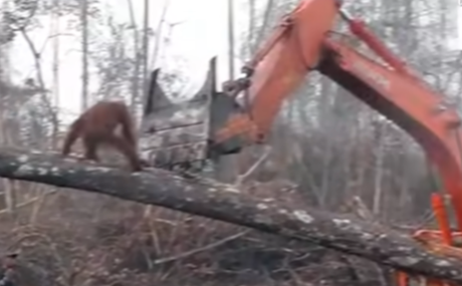
Author: Finley Hot Write
The Times
DEFEATING DEFORESTATION
Yesterday, around 2pm, in a rainforest in Borneo (South East Asia), an Orang-Utang was spotted violently defending its home from a vicious digger driver. Fortunately, an animal rescue team attended the scene, and the Orang-Utang left unharmed. The driver protested that it was not his fault.
As a logging company chopped down trees, an Orang-Utang was found not moving off its territory. By this time, a small crowd of children and locals had gathered while the Orang-Utang paced up and down the tree, or, in his case, its home. It started swinging from branch to branch as though saying, ‘This is my tree.’ It climbed down from the branches and the distressed Orang-Utang went to attack the deadly digger’s claw, only to be knocked off the tree. The manager of the company said that he would tell his employees to be more to be more careful when dealing with Orang-Utans. “I swear an oath to have more respect and to be more careful around Orang-Utans.”
Whn the Orang-Utang fell off the tree, the I.A.R. (International Animal Rescue) planned to tranquilise it. “It did nothing to deserve this,” protested an I.A.R. spokesman. A local got involved and claimed that she loved animals, especially rainforest animals, and that she found it interesting how biodiverse the ecosystem is.
Image of the Orang-Utang just about to attack the digger
The I.A.R. tranquillised the frantic Orang-Utang making it possible to transport it to a safer habitat. However, the dart only kicked in after about ten seconds; during that time the Orang-Utang tried to claim a new, shorter, tree but failed as the dart took affect.
An I.A.R member took a video and posted it on all kinds of social media: Twitter, YouTube, Instagram and a lot more than that. A tweet read, “ That poor Orang-Utang. It did nothing. I will never like a digger driver or a person who likes deforestation ever again.” Many YouTubes were made and one of them donated £1 million to the I.A.R. This video has gone viral and a police spokesman told the country to help defeat deforestation before it is too late ‘The Orang-Utang deserved what we deserve. Would you want that to happen to you, or your family? We all have a role to play in this. Stop it before its to late.’
Finley

