Slide 1
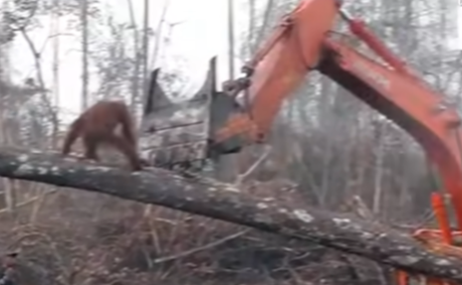
Name: Elinor Hot Write
The Times
Orangutan Defends Home From Destruction
At around 1am, on a beautiful crisp morning in the heart of Borneo (south east Asia), loggers tore into the sides of trees, destroying innocent and scared orangutan’s habitat for palm oil and paper. But what they do not know is the incredible long term damage they are doing to the local environment.
In the early hours of Tuesday morning, a terrifying encounter between an orangutan and loggers occurred. One of the loggers was interviewed and claimed that he did not see the orangutan until the Animal Rescue spotted it. He continued and said, “I never want to harm the orangutan and destroy its home but sadly if I don’t do my job then I won’t have a home and be able to feed myself.”
An eye witness to the event was a local resident - Jimmy. He described what he saw and stated, “I saw the bulldozer get pushed by the orangutan who appeared upset.” Jimmy went on and claimed that he had seen something like this before. “ It’s really upsetting to see the orangutan looking upset, anxious and angry with this bulldozer type machine,” concluded Jimmy.
Later that day, another eye witness told The Times how he tried to help the orangutan but
was scared that it would be frightened of him. That was the Animal Rescue. “Fortunately, we were able to get close enough to tranquilise the orangutan, "explained the Animal Rescue spokesperson. They claimed that they were shocked that anyone could ever do such a thing. And the tree was broken by the orangutan who was falling.
The incident had been filmed and went viral on the internet and comments had been written. One of the commenters wrote and said, “This is the most upsetting thing I have seen all year.” David Attenborough even commented and wrote, “I get why they are doing it but this shouldn’t be acceptable, I think that this should not be allowed.” he concluded.
Reported by Elinor

Slide 2
Headline – short, punchy, alliteration, play on words (pun)
Quotes – reported or direct speech
Introductory statement – who,what,when,where,why,how
Facts (it is certain) and opinions (many believe)
Formal tone
Third Person
Chronological order
Mainly past tense
Conclusion

