Slide 1
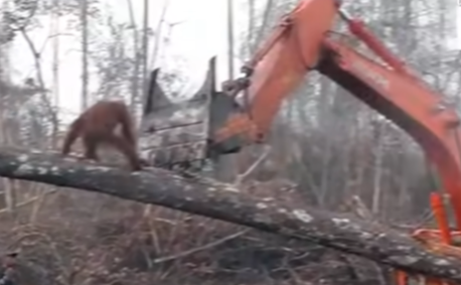
Name: Annabelle Hot Write
The Times
ORANG-UTAN ATTEMPTS DESTRUCTIVE DEFENCE OF HOME
At around 4pm, Sunday evening, the famous company ‘Palm.co’ were chopping down trees in a rainforest in Borneo (South East Asia) which is surrounded by Thailand, Malaysia and Indonesia. Right at that moment, some residents of this isolated road which they call ‘Rainforest Road’ found out what really happens behind those logos.
In the evening hours of last night, the diggers from this ‘caring’ company came to rampage though the beautiful rainforest animals call home. But just then, the residents of ‘Rainforest Road’ were taking a seemingly innocent walk by and immediately called the International Animal Rescue Service (IARS) because of what they saw. A poor orang-utan was helplessly defending its home from one of the smoking diggers sent from ‘Palm.co’. “How outrageous it was,” exclaimed one of the passers-by.
As soon as the ‘IARS’ arrived, someone pulled out their camera and started recording the scene but with one almighty swing from the digger, the orang-utan flew out of the tree. But did he give up? No! Even after he received a shot from the tranquillizer gun, he still fought for his home. David Attenborough even said something on the subject, “This proves my point of how this rare species of orang-utan is a great fighter but we can’t go and randomly destroy animal’s homes”.
The IARS and ‘Palm.co’ were interviewed and had very different opinions and answers to each other . The digger driver explained how he did not see or mean to hurt the orang-utan. But the IARS disagreed and said that this was a brutal and unforgivable attack on the poor thing. Then the representative of Palm.co said, “We’re doing what’s best”. Who’s side are you on?
After the world saw this incident, there were anguished comments on how this was unacceptable such as how the animals of our world should not be tampered with and “ In the future we should at least try not to hurt them.”
Reported By Annabelle

Slide 2
Headline – short, punchy, alliteration, play on words (pun)
Quotes – reported or direct speech
Introductory statement – who,what,when,where,why,how
Facts (it is certain) and opinions (many believe)
Formal tone
Third Person
Chronological order
Mainly past tense
Conclusion

