Slide 1
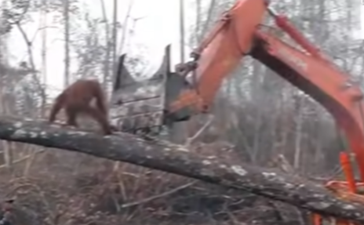
Name: Alistair Hot Write
The Times
ORANG-UTAN DEFENDS HOME FROM DEADLY DIGGER
Yesterday morning at 5 o’clock, a video was taken of an orangutan defending its home from a digger. Luckily, the Animal welfare society was on site and the animal was tranquilized shortly after their arrival.
In the early hours of Tuesday morning, an emergency phone call was received from a distressed local who had seen the orangutan
and digger. “When I was walking in the forest, I heard the sound of heavy machinery and distressed animal noises so I called the animal welfare society,” stated the local who raised the alarm.
Sir David Attenborough was interviewed on the matter: “This proves that animals do not have enough rights; if they did, the digger would have immediately stopped cutting down the tree
when it could be seen that an orang-utan was in the tree!” he explained. Sir David Attenborough also stated that the government should take drastic action against the logging company and deforestation.
The CEO of the felling company was also interviewed and asked why this had happened. “The company did nothing wrong!” argued the CEO. “This entire fiasco was down to the idiocy of the digger driver; he shall be fined and fired!”

