Slide 1
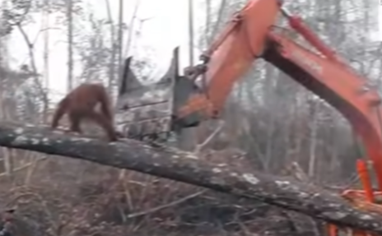
Name Alfie Hot Write
The Times
ORANGUTAN DEFENDS HOME
Yesterday in the rain forest in Borneo (South East Asia) , an orang-utan was spotted pacing up and down a tree, which was being destroyed.
The large digger was last spotted cutting down a large tree. The orang-utan got to the point where it hit the digger because it was so desperate.
After a while, Animal Rescue came to the scene and followed the orang-utan from below. They got out their tranquilising guns and shot him so they could get him some where safe.
As this video went viral on twitter almost every one was
in on it. The first witness, David Attenborough, said that we needed to make a stop to this nonsense. The second witness stated that, ”If this keeps up then the orang utang will soon be extinct.”
In conclusion, clearly we need to do something. How can we change our ways? Stop getting palm oil? We could limit using palm oil or not buy it at all - that could benefit our planet and our life.

Slide 2
Headline – short, punchy, alliteration, play on words (pun)
Quotes – reported or direct speech
Introductory statement – who,what,when,where,why,how
Facts (it is certain) and opinions (many believe)
Formal tone
Third Person
Chronological order
Mainly past tense
Conclusion

