Slide 1
KS2 Assessments
End of Key Stage Two Assessments 2024
Finchampstead CE (Aided) Primary School

Slide 2
KS2 Assessments
Contents
1 | What are end of key stage two assessments?
2 | When do they happen?
3 | What are the children tested on?
4 | How are the tests administered?
5 | What happens with the results?
6 | How can I help my child?

Slide 3
KS2 Assessments
What are end of key stage 2 assessments?
What you might know as SATs or Standard Attainment Tests, are national curriculum tests that are usually taken by children at the end of key stage two.
All children are assessed during the last term of year 6; for 2024, this is in the week beginning 13th May.
The aim of the tests is to establish whether pupils are working at an expected level in English and maths for the end of primary school and the start of secondary school.
The results of the tests do not tell us how accomplished children are in other areas, such as sport, music or art.
Pupils sit six different tests in three subject areas: maths, English reading and English grammar, spelling and punctuation.
English writing and science judgements are made by the pupils’ teachers through teacher assessment, based on evidence of independent writing and work gathered over the course of year 6. Our judgements will be moderated by the local authority.
Contents

Slide 4
KS2 Assessments
When do they happen?
Every primary school will test their pupils on the same subject at the same time during the week beginning 13th May 2024. The schedule of tests for this year looks like this:
Assessment week 2024 | Tests
Monday 13th May | English grammar, punctuation and spelling Paper 1: questions Paper 2: spelling
Tuesday 14th May | English reading
Wednesday 15th May | Mathematics Paper 1: arithmetic Paper 2: reasoning
Thursday 16th May | Mathematics Paper 3: reasoning
Contents

Slide 5
KS2 Assessments
What are the children tested on?
English grammar punctuation and spelling
Paper 1: questions (45 minutes) 50 marks
A combined question and answer booklet which assesses pupils’ understanding of the grammar, punctuation and spelling elements of the national curriculum English programmes of study for key stage two.
Paper 2: spelling (15 minutes but not strictly timed) 20 marks
The paper that pupils receive has 20 sentences, each with a missing word. The teacher reads the sentences one at a time and pupils write in the missing word on their paper.
English
Reading
(1 hour) 50 marks
Pupils will have a reading booklet with three different texts to read and a corresponding question and answer booklet. The texts are presented in increasing levels of difficulty and pupils’ comprehension skills will be assessed against the comprehension elements of the English programme of study for key stage two. During the reading paper, a child’s inference and deduction skills are thoroughly tested. They will also be expected to answer questions on authorial choices: explaining why an author has chosen to use particular vocabulary, grammar and text features. Some questions are multiple choice or selected response; others require short answers and some require an extended response or explanation.
Contents

Slide 6
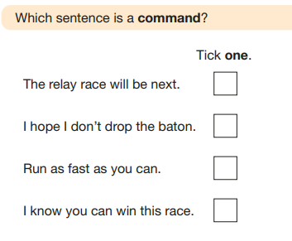
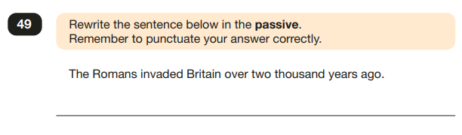

Slide 7
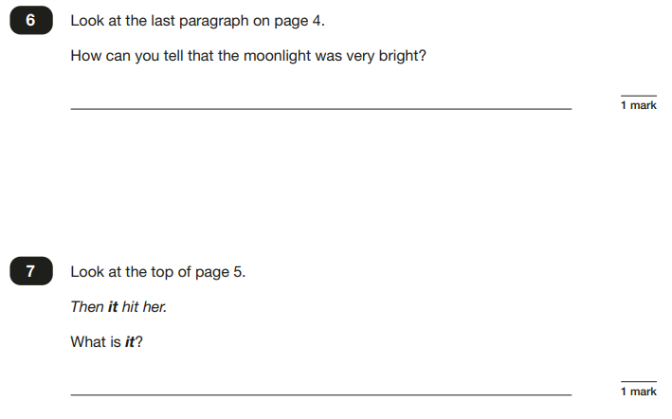
Example Reading Question

Slide 8
KS2 Assessments
What are the children tested on?
Paper 1: arithmetic (30 minutes) 40 marks
Pupils will have a booklet of arithmetic questions based on the national curriculum maths key stage two programmes of study. Paper 1 is for arithmetic lasting for 30 minutes, covering calculation methods for all operations, including use of fractions, percentages and decimals.
Questions gradually increase in difficulty. Not all children will be expected to access some of the more difficult questions later in the paper.
*8 marks go towards long multiplication/division questions.
Papers 2 and 3: reasoning (40 minutes each) 35 marks each
Both papers will ask children to reason and solve problems, again based on the national curriculum maths programmes of study. Pupils will still require calculation skills but will need to answer questions in context and decide what is required to find a solution.
Mathematics
Contents

Slide 9
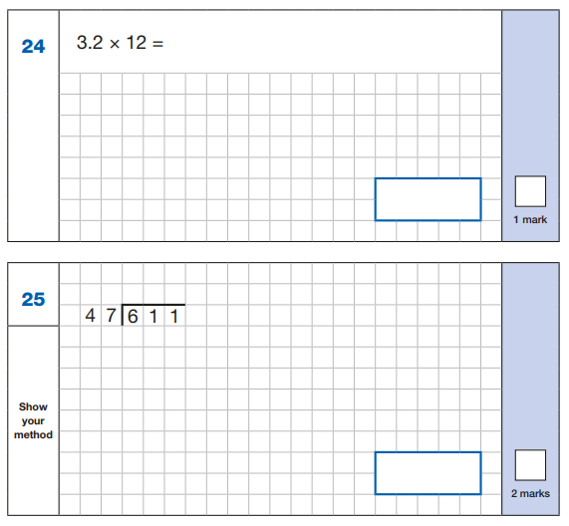
Arithmetic Example Questions

Slide 10
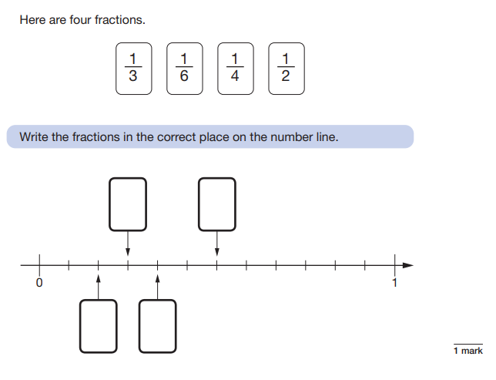
Reasoning Paper Example Question

Slide 11
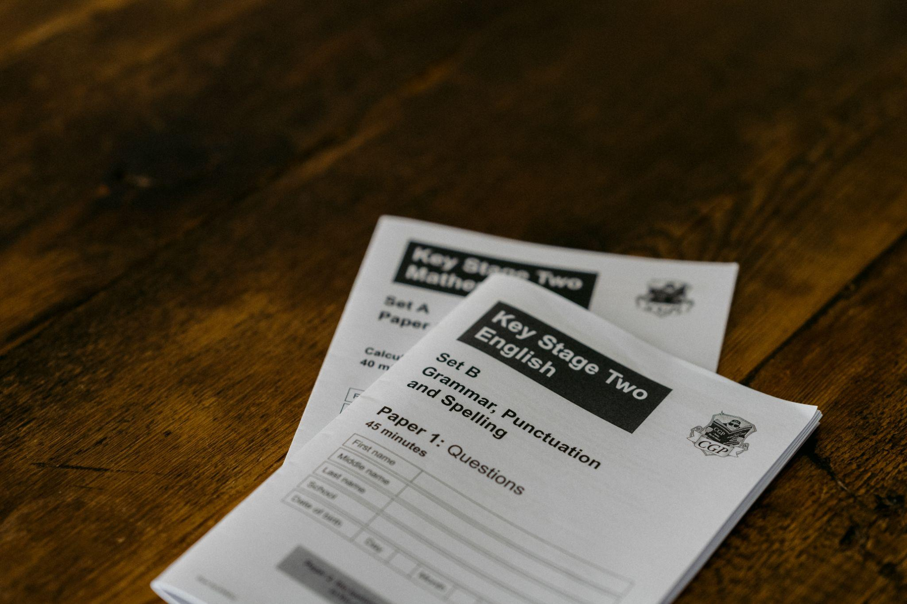
KS2 Assessments
How are the tests administered?
Memory theory suggests that we recall facts better in the same environment that we learn them so the children will remain in the classroom for the SATs. For those who are anxious, this is a more familiar environment for them to work in.
The Year 5 will work with a supply teacher for the mornings of SATs week allowing the Year 6 to space out on single desks in rows, seated alphabetically.
We begin the day with a shared breakfast and Yoga session to relax the children.
Some children are granted access arrangements to support their focus and concentration. This may be, for example, rest breaks or extra time, provided they pass the criteria for eligibility. They work separately with a familiar member of staff.
Contents

Slide 12
KS2 Assessments
What happens with the results?
For 2024, school results in the end of key stage assessments will be published on the Key Stage 2 Performance Measures Website .
School results will be shared with the school, their local authority or academy trust and Ofsted to support school improvement.
Each child will receive a scaled score for their performance on the tests. This is a score between 80 and 120, where a score of 100 is considered to be average or working at the expected level of attainment at the end of primary school.
Provided we have approved the data, we aim to share pupils’ results in their end of year written report, which is sent home to parents in July.
Contents

Slide 13
KS2 Assessments
How can I help my child?
Support your child to complete any home learning tasks sent home, such as spelling activities, reading comprehensions and maths sheets.
Use online activities like Times Tables Rock Stars, Education City or White Rose Maths revision videos, (which can be found via the link on the Goldfinch webpage on our school website) to practise skills at home.
Make sure they go to bed at a reasonable time, have a good breakfast and arrive at school on time during the assessment week.
Encourage them to try their best, commend their efforts and plan to celebrate their hard work at the end of the testing week, rather than focusing on the test results.
Contents

Slide 14
How to Help Your Child with Reading
Listening to your child read can take many forms.
First and foremost, focus developing an enjoyment and love of reading.
Enjoy stories together – reading stories to your child at KS1 and KS2 is equally as important as listening to your child read.
Read a little at a time but often, rather than rarely but for long periods of time!
Talk about the story before, during and afterwards – discuss the plot, the characters, their feelings and actions, how it makes you feel, predict what will happen and encourage your child to have their own opinions.
Look up definitions of words together – you could use a dictionary, the Internet or an app on a phone or tablet.
All reading is valuable – it doesn’t have to be just stories. Reading can involve anything: fiction, non-fiction, poetry, newspapers, magazines, football programmes and TV guides.
Visit the local library - it’s free!

Slide 15
How to Help Your Child with Writing
Practise and learn weekly spelling lists using a range of strategies – make it fun!
Encourage opportunities for writing such as letters to family or friends, shopping lists, notes or reminders, stories and poems.
Write together – be a good role model for writing.
Encourage use of a dictionary to check spelling and a thesaurus to find synonyms and expand vocabulary.
Allow your child to use a computer for word processing, which will allow for editing and correcting of errors without lots of crossing out.
Remember that good readers become good writers! Identify good writing features when reading with your child (e.g. vocabulary, sentence structure and punctuation).
Show your appreciation: praise and encourage, even for small successes!

Slide 16
How to Help Your Child with Maths
Play times tables games.
Play mental maths games including counting in different amounts, forwards and backwards.
Encourage opportunities for telling the time.
Encourage opportunities for counting coins and money; finding amounts or calculating change when shopping.
Look for examples of 2D and 3D shapes around the home.
Identify, weigh or measure quantities and amounts in the kitchen or in recipes.
Play games involving numbers or logic, such as dominoes, card games, darts, draughts and chess.

Slide 17
KS2 Assessments

